Slide 1






TRACKR-UPGRADATION Team-5

Slide 2

CDL
Conestoga Design Limited(CDL) is a medical imaging scanner sales company.
On January 2014, CDL introduced TrackR, a wearable fitness monitor.
TrackR became a great success and sales volume increases.
CDL got an award as TrackR was selected at CES because of its innovative design.

Slide 3

Introduction
TrackR is a home fitness monitor launched by CDL.
CDL skipped major testing and elicitation just to save time.
CDL doubles its staffing and got successful sales with the TrackR.
After reaching record sales volume, CDL struggled in receiving devices back.
This resulted in Bankruptcy and many questions were aroused.

Slide 4
Identified Flaws
1. Navigation flaws: –Users are not able to proceed further as there are no connection between the application.
2. Unnecessary widgets: – Few of the widgets provided on the application does not have any purpose.
3. Improper Visualization: Visualization of the application is not up to the mark. Screen backgrounds are black which is not attractive while using the application.
4. Blank windows: – Few buttons on the application are creating blank pages which results in limiting the efficiency and output of the app.

Slide 5
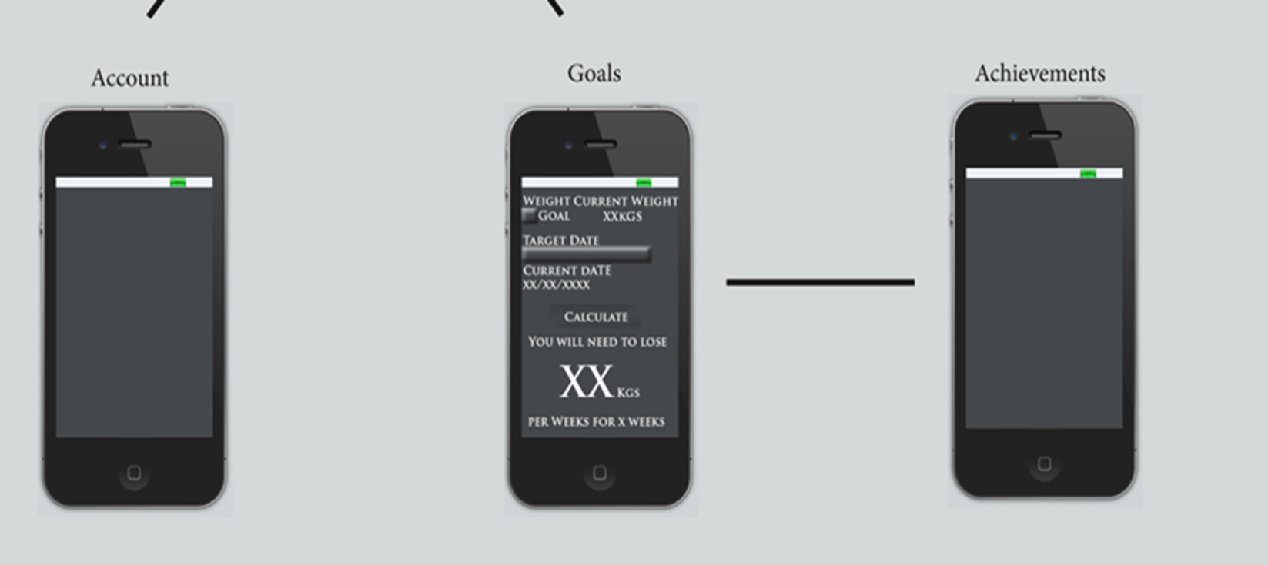
Identified Problems

Slide 6
Administrative Negligence
CDL not only face application Flaws but also faced negligence from administration like:
Application Upgradation
Having good Social Media Marketing
Performing sentimental Analysis
Analyzing problem
Hiring good developers to suggest best solutions

Slide 7
Solution
Administrative measure
Application measures

Slide 8
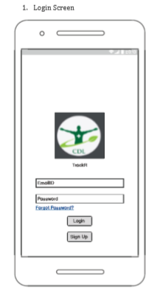
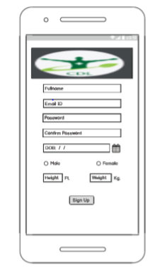
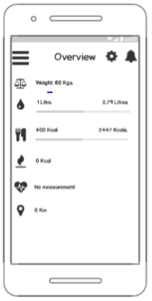
Prototype

Slide 9
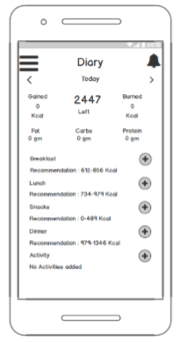
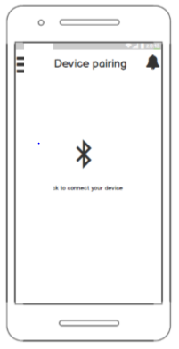
Prototype Cont.

Slide 10
Agile Methodology
Supports in adopting many changes in the product
Old product is updated based on daily problems
Increases the flexibility of using new technologies
Adds more quality and satisfaction to the product
Customers are also involved their feedback is very important.

Slide 11

Social Media Marketing Strategy
To launch the product on social media.
Target audience.
Various methods which will be used are as followed:-
Facebook
You tube
Instagram
Online surveys
Online discounts.

Slide 12
Guidance to marketing and developing teams
They should create more innovative and interesting content.
Meeting should be done daily.
Campaigning should be done as a team.

Slide 13
CDL Social Marketers
Support marketing management team
Produce content for eCommerce and Individual Artists
Requirements
Promoting/Advertising experience: 1-5 years
Long range informal communication: 1-5 years

Slide 14
Challenges Involved
Technical Support: CDL has an app with no tech support staff, they need a support team either full time or part time so that they can resolve technical issues.
Customer Handling: CDL support staffs must handle the complaints of angry customers
Bankruptcy: CDL is facing Bankruptcy because of major returns from the customers
Losing the market: CDL is losing the market due to failure of TrackR which will be affecting by Image scanners

Slide 15
Procure and Onboard App Developers
Creating social media content
Manage the marketing budget
Daily maintenance of application creation
Requirements
Degree in social media marketing
Proficient with Excel, Word

Slide 16
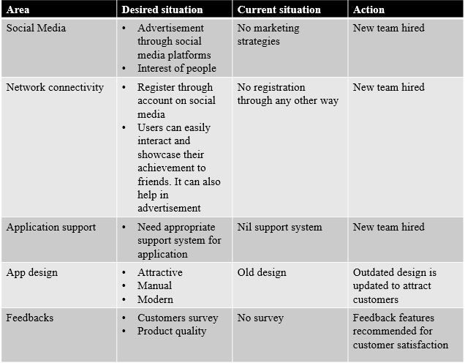
Gap Analysis

Slide 17
Suggestions for long term maintenance of revised application
Continuously track the application to easily know about the customer requirement
Monitor and verify with customers who are regularly using the application.
Keep track of the customers feedback
Keep a check on surveys filled by the customers to know about the response of the application

Slide 18
Benefits
• The upgraded version of the application will boost up number of customers and clients more efficiently.
• The upgraded version will help to meet customer’s satisfaction level.
• The positive remarks from satisfied customers will boost its marketing and will help in further collaboration.
• Advertisements of app through social media is prefect platform for is to grow.
• Moreover, social media will help us to now analyze the choice of customers.

Slide 19
Assumptions
• Budget should be minimal.
• We will assume that the application is working properly on both IOS and android devices without any defects and bugs.
• Revised application is successfully upgraded without any bugs or issues by the developer’s team.
• Customers have no issue with the design of the device and the way it looks, all they need is a revised application which will be defects free.

Slide 20
Conclusion
The innovative strategies for marketing and new hired team will boost up the company’s performance.
Moreover, the promotion of device with innovative methods will improve its efficiency and values because of upgradation.
This will ultimately shoot up company marketing and partnership chances.
The goal coordination of different sections of company will look after needs and demands of customers for the benefit of company.

Slide 21


Slide 22
Reference
(n.d.). Retrieved February 20, 2020, from https://www.bing.com/images/search?view=detailV2&ccid=C0vxMl4J&id=534ECB636F074C65821C9C26F2AF7F8824987BDD&thid=OIP.C0vxMl4JH7gEnfGrF3-8OwHaD1&mediaurl=http://cahmagroup.com/wp-content/uploads/2016/10/01.jpg&exph=723&expw=1395&q=introduction+images&simid=608055927068952728&selectedIndex=174&ajaxhist=0
(n.d.). Retrieved February 20, 2020, from https://www.bing.com/images/search?view=detailV2&ccid=XpqKVgb+&id=49511E541D96049FF50F41B69DF7BE2127CE6420&thid=OIP.XpqKVgb-fKh-VUOTiz2hkAHaFZ&mediaurl=https://vchipedu.com/images/about-us.jpg&exph=4000&expw=5488&q=about+images&simid=608041715053756886&selectedIndex=17&ajaxhist=0
(n.d.). Retrieved from https://conestoga.desire2learn.com/d2l/le/content/323280/viewContent/6467511/View
(n.d.). Retrieved February 20, 2020, from https://conestoga.desire2learn.com/d2l/le/content/323280/viewContent/6467512/View
(n.d.). Retrieved February 20, 2020, from https://conestoga.desire2learn.com/d2l/le/content/323280/viewContent/6467527/View
(n.d.). Retrieved February 20, 2020, from https://conestoga.desire2learn.com/d2l/le/content/323280/viewContent/6467528/View
(n.d.). Retrieved February 20, 2020, from https://conestoga.desire2learn.com/d2l/lms/dropbox/user/folders_history.d2l?db=313142&grpid=331736&isprv=0&bp=0&ou=323280
(n.d.). Retrieved from https://www.bing.com/images/search?view=detailV2&ccid=ObIQOCDB&id=569C11410D3DCD2CEBE3C020F4E8C1C492D179D2&thid=OIP.ObIQOCDBcuZguOco0nMNZQHaE9&mediaurl=http://1.bp.blogspot.com/_3_2FCxXqZPQ/TBT18M5eUfI/AAAAAAAAO8U/hFWk97q2obM/s1600/thank_you_quote_wallpaper.jpeg&exph=335&expw=500&q=thankyou&simid=608031450078971614&selectedIndex=7&ajaxhist=0

